Slide 1
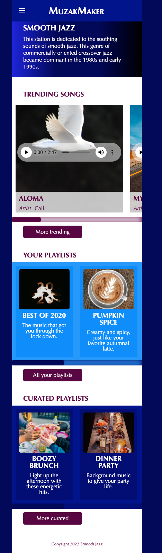
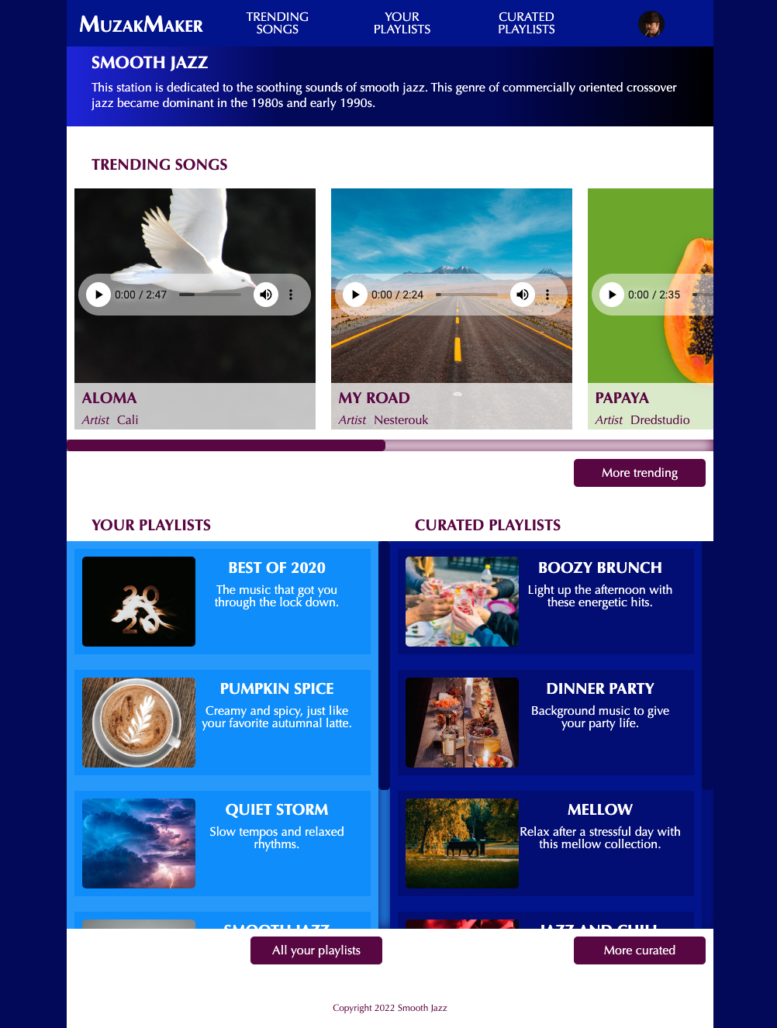
On hover, background-color changes to #590242
375px
834px
MuzakMaker is the first <li> in th <ul> and is styled differently than the others, small-caps
Hamburger menu uses an input checkbox to reveal the whole nav ul
See example https://codepen.io/professor-carrasquilla/pen/dyERNoe and video https://youtu.be/fomOD0weP1c?si=U2fd30t4vvuRKuvH
The navigation expands to see all the links which start out hidden by the hamburger menu.
Scrolls to reveal 5 songs
Custom audio player See code provided with Content folder in Google Drive
Custom slider See video https://youtu.be/wGWO5sm8iKM
html background-color is #020659
And body is set to margin:0 auto to display in the center of the viewport window
Moves from the left to the right
Scrolls to reveal 5 playlists
Changes from vertical to horizontal
using only css, no new images
Custom slider
Scrolls to reveal 5 playlists
Changes from vertical to horizontal
using only css, no new images
Custom slider
On hover, background-color changes to #020659

Slide 2
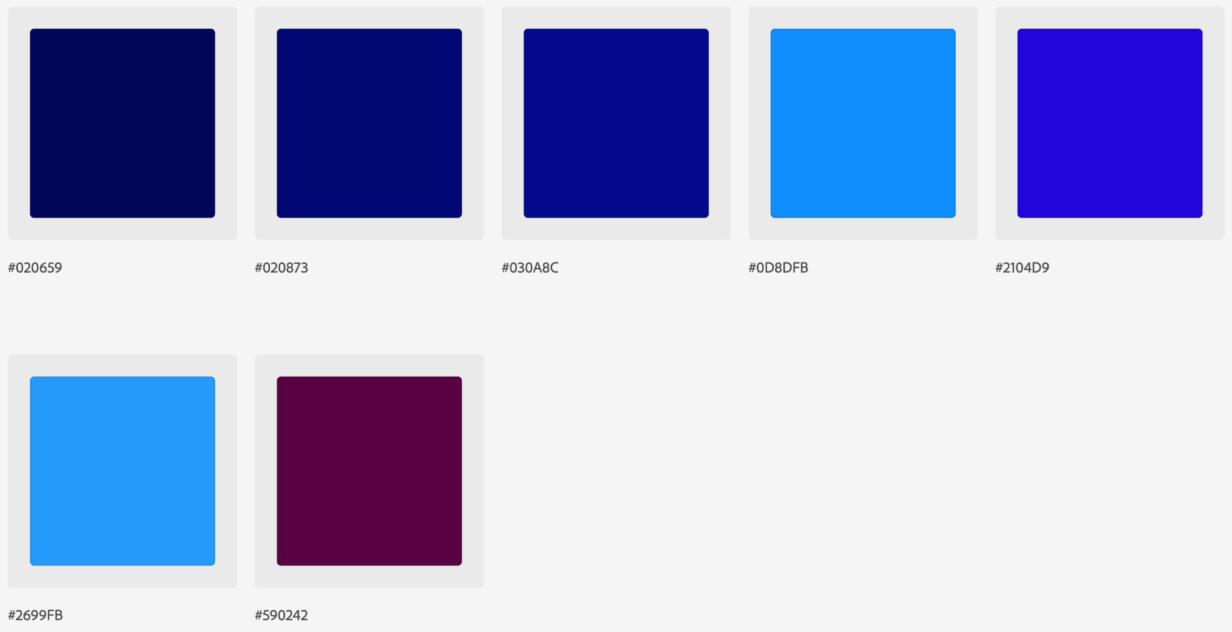
Color Palette

Slide 3
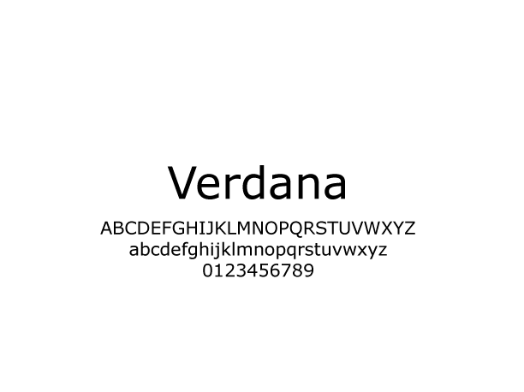
Typography
font-family: Verdana, Geneva, Tahoma, sans-serif;

Slide 4
Font Sizes
h1 {font-size:1.25em;}
h2, h3 {font-size: 1em;}
p, dl, dd {font-size: 1em;}
footer p {font-size: .75em;}

